Slide 1

Sonic Levitation
Milkyas Afework; Kara Stead
5/16/17

Slide 2
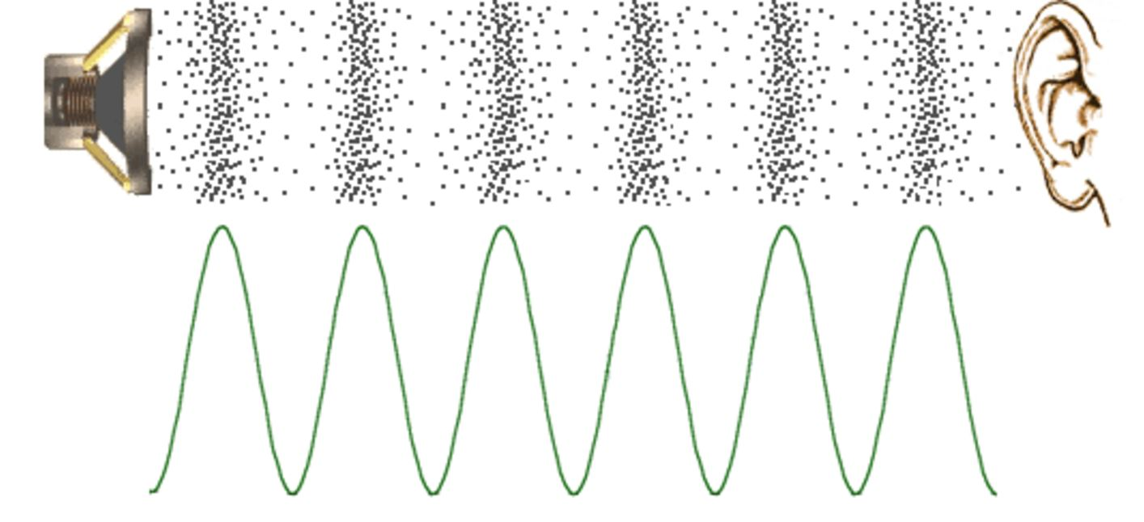
Introduction of Sound
Sound is a mechanical wave that is created by vibrating objects and propagated through a medium from one location to another.
Soundwaves can be categorized in to three sections:

Slide 3
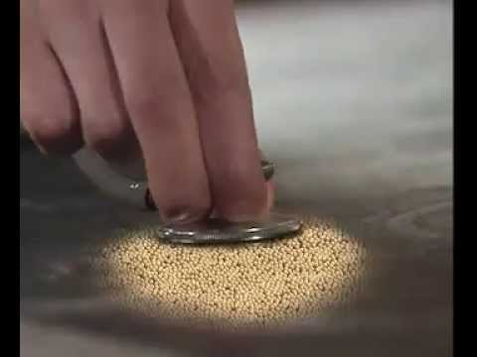
How sound travels
H. (2015, January 18). Retrieved May 15, 2017, from https://www.youtube.com/watch?v=q9ezMbDpIHI

Slide 4
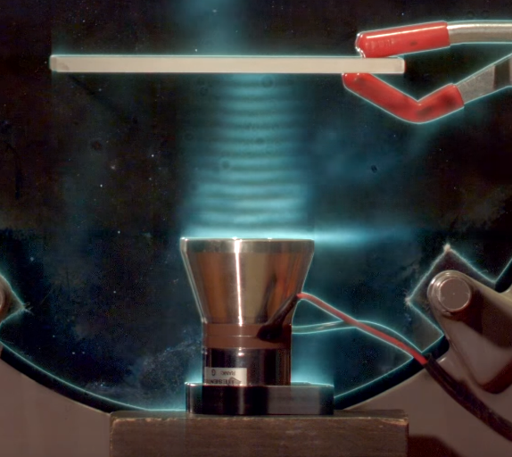
Standing Waves
Standing Waves: Waves that can occur in any medium as long as it is enclosed (i.e. waves must be reflected back to source)
Only particular wave length and frequency are going to setup standing waves.
https://sciencedemonstrations.fas.harvard.edu/presentations/schlieren-optics

Slide 5

Theoretical Calculations
C=λf
C: Speed of Sound = $331\frac{m}{s}+\frac{0.6\frac{m}{s}}{°C}$
λ: Wave Length
f: Frequency (28KHz)
https://www.nde-ed.org/EducationResources/HighSchool/Sound/tempandspeed.htm

